Slide 1

Public engagement activity
Amaan Mujawar

Slide 2
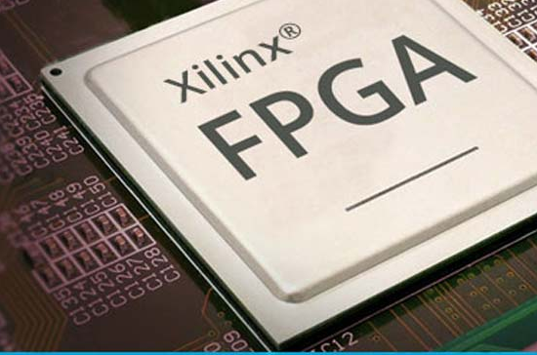

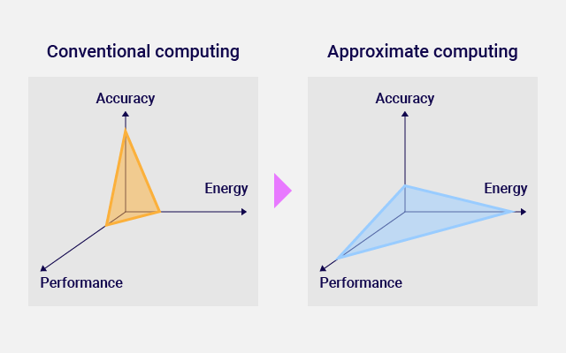
ABOUT the project
Implement an Arithmetic Unit Utilizing Approximate Computing into RISC-V SoC.
Supervisor: Mr. Neil Powell
2
Notes:
Hello, My name is Amaan Mujawar, and today I’ll be presenting my project titled "Implement an Arithmetic Unit Utilizing Approximate Computing into RISC-V SoC." This project is supervised by Mr. Neil Powell and is part of my work at the University of Sheffield in the Department of Electronics and Electrical Engineering. I’ll be discussing the background, motivation, progress, and future directions of this project.

Slide 3
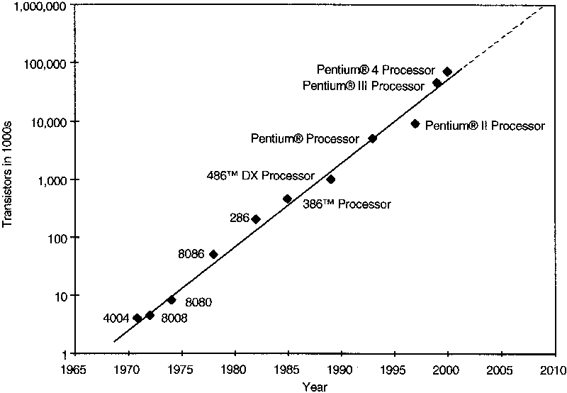
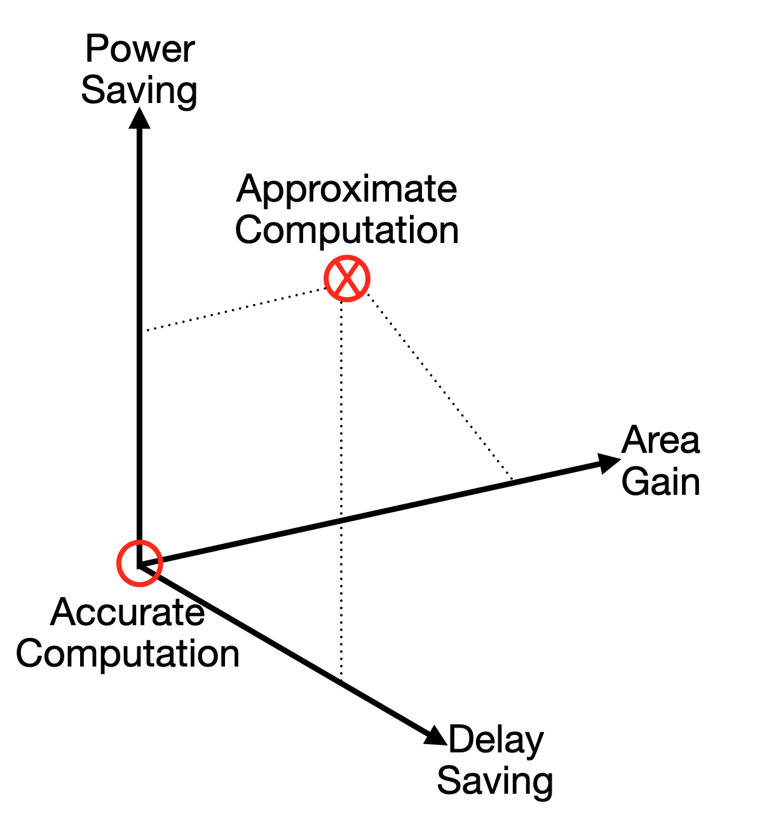
Background & motivation
Context
Growing demand for high-performance computing in machine learning, computer vision, and multimedia processing.
challenge
Traditional computing approaches are limited by the slowing of Moore's Law.
opportunity
Approximate computing allows controlled errors for faster and energy-efficient computation.
importance
Enables energy-efficient digital systems, suitable for error-tolerant applications like image processing.
Notes:
Approximate computing is an emerging technique that allows a small degree of error in computations to reduce power consumption and execution time. This approach is especially relevant today as the demand for high-performance computing grows rapidly in fields like machine learning, computer vision, and multimedia processing. However, traditional methods are limited by the slowing of Moore's Law, which states that the number of transistors on a chip doubles every two years. As this trend slows, new approaches are needed to achieve performance and energy efficiency gains. Approximate computing offers a solution by introducing controlled errors in non-critical computations, making it ideal for error-tolerant applications like image processing.

Slide 4
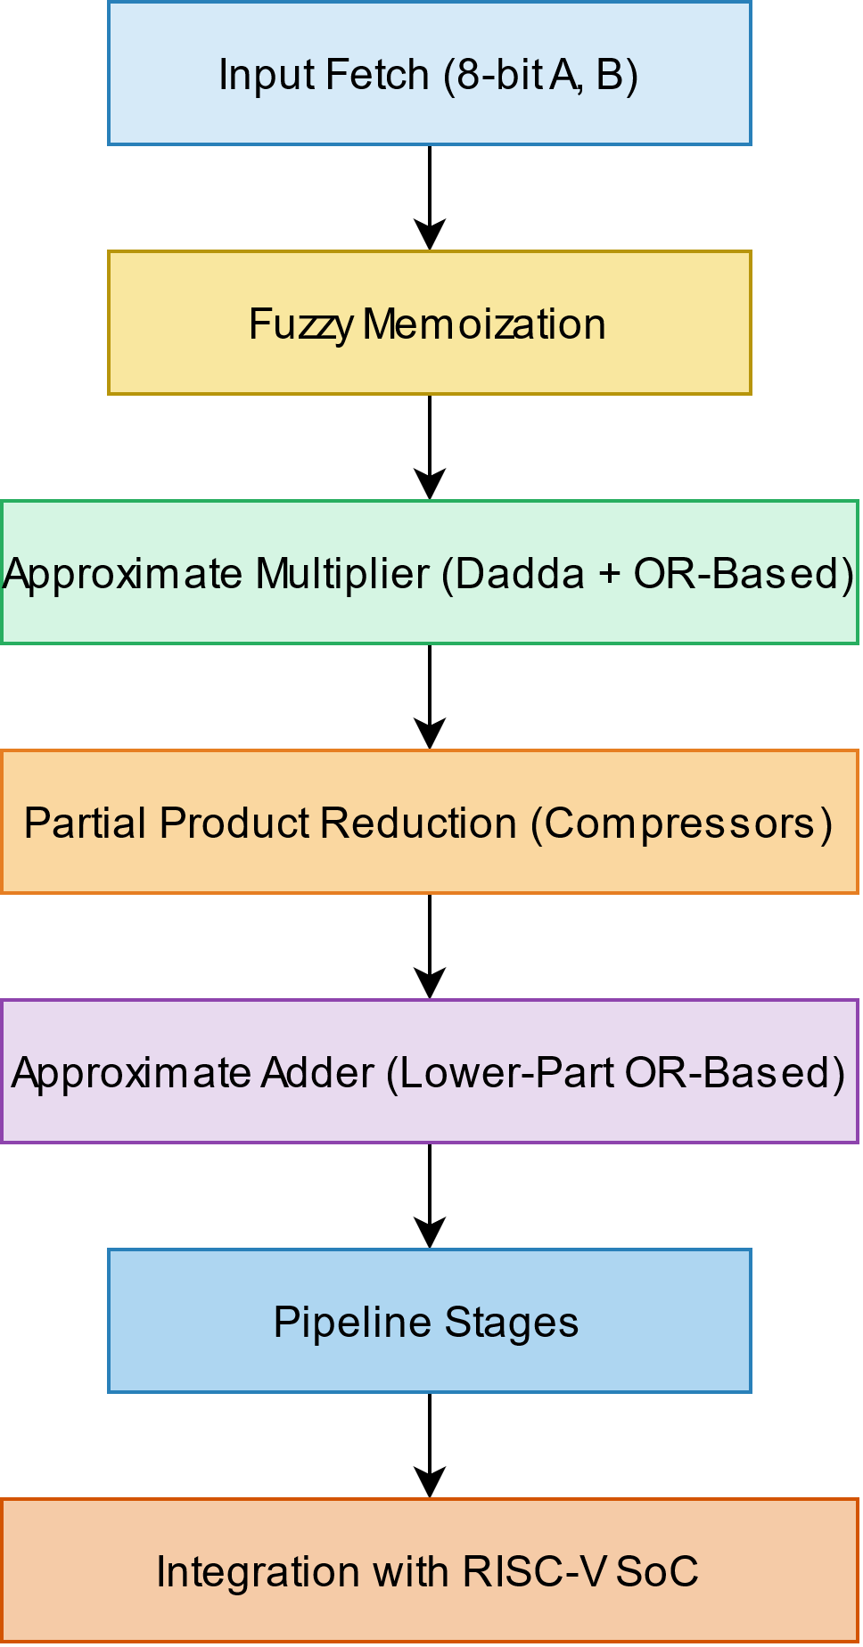
ARCHITECTURE
8-bit Approximate MAC Unit
Input Fetch Stage
8-bit operands (A and B) for multiplication
Inputs are passed into the fuzzy memoization block to check for stored approximate results
Fuzzy Memoization Block
Caches previous computations to avoid redundant calculations
Uses Hamming distance to find a similar previously stored input-output pair.
If a match is found, cached result is used instead of recalculating.
Approximate Multiplication Stage
Lower-Part OR-based Approximate Multiplier:
MSB (Most Significant Bits) handled with a Dadda Multiplier
LSB (Least Significant Bits) approximated using OR-based logic
Partial Product Reduction Stage
Uses compressor-based approximate multipliers
Approximate Addition Stage
Accumulation performed using Lower-Part OR-based Approximate Adders
Notes:
This project specifically addresses the challenge of balancing accuracy, power consumption, and speed in arithmetic units. In this context, we’re using the Nexys-A7 FPGA and Xilinx Vivado Design Suite for simulations and testing. The goal is to achieve enhanced computational efficiency while maintaining minimal accuracy loss. To do this, we are implementing three key techniques:
Lower-Part OR-based Approximate Multipliers for faster partial product calculations.
Approximate Adders to accumulate results efficiently.
Fuzzy Memoization to cache and reuse results in repetitive calculations, reducing redundant computations. Together, these techniques form a powerful combination for building efficient, error-tolerant arithmetic units.

Slide 5
Real-World Problem Addressed
Energy-Efficiency
Traditional computation
Reduced power consumption by allowing controlled errors
Lower energy requirements make it suitable for battery-powered devices
Precise arithmetic units consume more power and area
High accuracy but less energy-efficient
Approximate computing
Ideal tasks
Trades off accuracy for efficiency, reducing power and area
Suitable for error-tolerant applications like image processing and AI
Image processing (denoising, compression)
Machine learning
Signal processing in embedded systems
5
Notes:
One of the biggest challenges in modern computing is balancing performance with power consumption. Traditional precise computation methods require significant power and resources, making them less efficient for data-intensive tasks. Approximate computing addresses this by allowing minor inaccuracies, leading to faster computations with lower power consumption. This makes it especially useful for tasks where perfect accuracy is not necessary, like image and video processing, where slight inaccuracies are imperceptible to the human eye. By leveraging this, the project aims to design a highly efficient arithmetic unit for a RISC-V System on Chip.

Slide 6
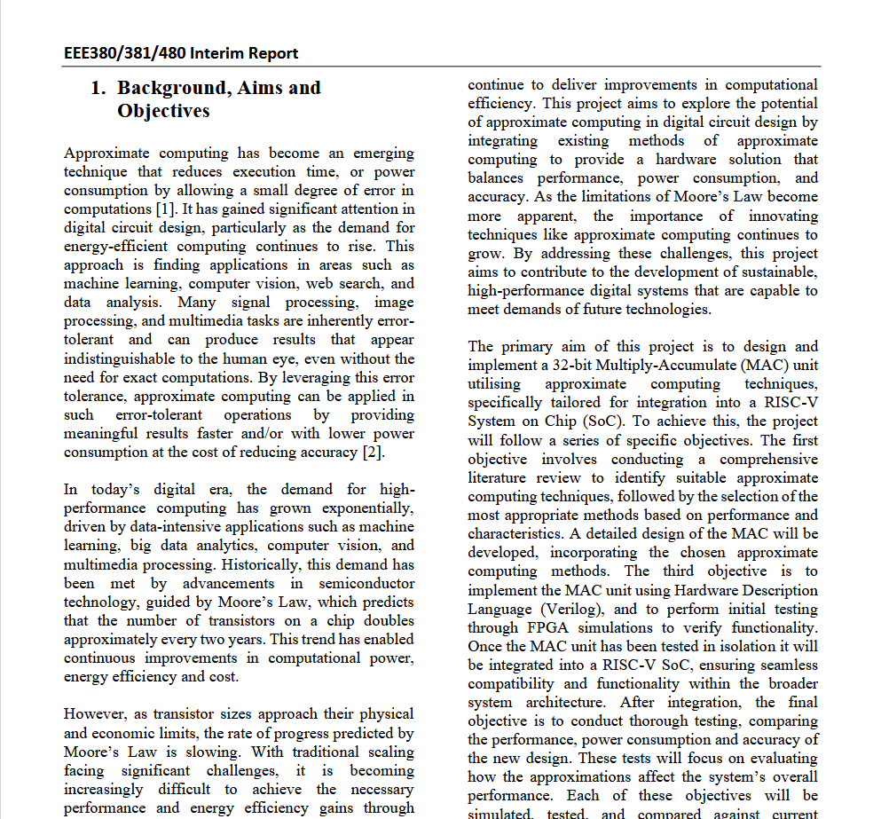
Aims & Objectives
AIMS
Design and implement an 8-bit Multiply-Accumulate (MAC) unit using approximate computing techniques
Implement an arithmetic unit utilizing approximate computing into a RISC-V SoC
Optimize the arithmetic unit for energy efficiency while maintaining acceptable computational accuracy.
OBJECTIVES
Design and simulate the MAC unit using Verilog on FPGA
Integrate the MAC unit into a RISC-V SoC
Evaluate, analyze and compare performance, power consumption, and accuracy against traditional designs
Validate the design using simulation tools
Assess the impact of approximation on computational accuracy
Evaluate the MAC unit’s performance in a fuzzy memoized FIR filter for image processing
Notes:
The primary aim of this project is to design and implement a 32-bit Multiply-Accumulate (MAC) unit using approximate computing techniques for integration into a RISC-V SoC. To achieve this, the project follows several specific objectives:
Conduct a comprehensive literature review to select suitable approximation methods.
Design and simulate the MAC unit using Verilog and test it on FPGA hardware.
Integrate the MAC unit into the RISC-V SoC framework, ensuring compatibility and functionality.
Finally, evaluate its performance, power consumption, and accuracy against traditional designs to measure the trade-off between efficiency and precision.

Slide 7
Problem specification
Problem:
Balancing accuracy, power consumption, and speed in arithmetic units
Expected Results:
Enhanced computational efficiency with minimal accuracy loss
Reduced power consumption and chip area
Methodology:
Using Verilog for implementation and FPGA simulations
Implementing Approximate Adders and Approximate Multipliers based on existing designs
Notes:
This project specifically addresses the challenge of balancing accuracy, power consumption, and speed in arithmetic units. In this context, we’re using the Nexys-A7 FPGA and Xilinx Vivado Design Suite for simulations and testing. The goal is to achieve enhanced computational efficiency while maintaining minimal accuracy loss. To do this, we are implementing three key techniques:
Lower-Part OR-based Approximate Multipliers for faster partial product calculations.
Approximate Adders to accumulate results efficiently.
Fuzzy Memoization to cache and reuse results in repetitive calculations, reducing redundant computations. Together, these techniques form a powerful combination for building efficient, error-tolerant arithmetic units.

Slide 8
SIMULATION RESULTS - ADDER
8
Notes:
So far, significant technical progress has been made. We began by implementing and testing a pipelined MAC unit on FPGA, which serves as a benchmark to measure the improvements made by the approximate designs. Following this, the conceptual design of the Approximate Arithmetic Unit Design (AAUD) was completed, and initial implementation of approximate multipliers and adders is underway. Preliminary results show that the pipelined MAC unit achieves promising throughput and power efficiency. However, we are continuously refining the design to fully integrate the approximation techniques for better performance.

Slide 9
SIMULATION RESULTS - Multiplier
9
Notes:
So far, significant technical progress has been made. We began by implementing and testing a pipelined MAC unit on FPGA, which serves as a benchmark to measure the improvements made by the approximate designs. Following this, the conceptual design of the Approximate Arithmetic Unit Design (AAUD) was completed, and initial implementation of approximate multipliers and adders is underway. Preliminary results show that the pipelined MAC unit achieves promising throughput and power efficiency. However, we are continuously refining the design to fully integrate the approximation techniques for better performance.

Slide 10
Analysis and Significance
10
Notes:
So far, significant technical progress has been made. We began by implementing and testing a pipelined MAC unit on FPGA, which serves as a benchmark to measure the improvements made by the approximate designs. Following this, the conceptual design of the Approximate Arithmetic Unit Design (AAUD) was completed, and initial implementation of approximate multipliers and adders is underway. Preliminary results show that the pipelined MAC unit achieves promising throughput and power efficiency. However, we are continuously refining the design to fully integrate the approximation techniques for better performance.

Slide 11
UNIT TESTING - Adder
11
Notes:
So far, significant technical progress has been made. We began by implementing and testing a pipelined MAC unit on FPGA, which serves as a benchmark to measure the improvements made by the approximate designs. Following this, the conceptual design of the Approximate Arithmetic Unit Design (AAUD) was completed, and initial implementation of approximate multipliers and adders is underway. Preliminary results show that the pipelined MAC unit achieves promising throughput and power efficiency. However, we are continuously refining the design to fully integrate the approximation techniques for better performance.

Slide 12
UNIT TESTING - Multiplier
12
Notes:
So far, significant technical progress has been made. We began by implementing and testing a pipelined MAC unit on FPGA, which serves as a benchmark to measure the improvements made by the approximate designs. Following this, the conceptual design of the Approximate Arithmetic Unit Design (AAUD) was completed, and initial implementation of approximate multipliers and adders is underway. Preliminary results show that the pipelined MAC unit achieves promising throughput and power efficiency. However, we are continuously refining the design to fully integrate the approximation techniques for better performance.

Slide 13
Comparison: Aims and milestones
Achievements
Established a benchmark with a pipelined MAC unit
Conceptual and partial implementation of AAUD architecture
Implemented Approximate Adder and Approximate Multiplier
Unit testing completed and modules validated
Pending Tasks
Complete integration of approximate multipliers and adders
Explore Fuzzy memoization implementation
Conduct comprehensive testing for power, speed, and accuracy
Compare against other approximation units to evaluate performance
Notes:
The key finding so far is the trade-off between accuracy and efficiency. By introducing controlled errors, we can significantly reduce power consumption and increase speed. Fuzzy memoization, in particular, has shown great potential in reducing redundant calculations in image processing tasks. The significance of this project lies in its ability to create scalable, energy-efficient arithmetic units. It provides a solution to the limitations of traditional computing scaling methods and paves the way for more efficient digital systems.

Slide 14
Future Work Plan
Next steps
Complete implementation of approximate arithmetic units
Integrate AAUD into RISC-V SoC and conduct full system testing
Evaluate performance against traditional MAC units
Long-term
Explore further optimizations with different approximation methods
Investigate potential applications in other error-tolerant domains, such as machine learning
Notes:
Comparing the progress against the initial aims and objectives: We have successfully established a benchmark with the pipelined MAC unit and completed the conceptual design of the AAUD. Partial implementation of approximate multipliers and adders is ongoing, and initial results are promising. However, we still need to complete the integration of all approximation techniques and conduct comprehensive testing for power, speed, and accuracy. This comparison helps us identify gaps and guides our next steps to achieve the project’s full potential.

Slide 15
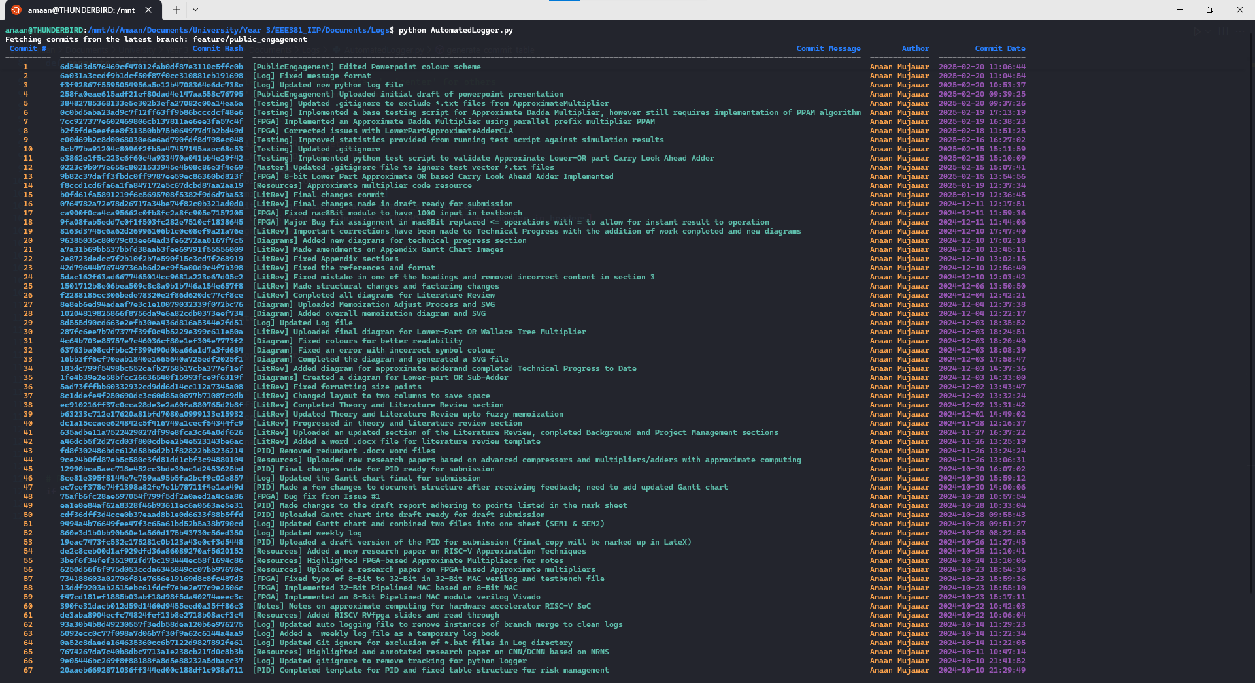
Notes:
The primary aim of this project is to design and implement a 32-bit Multiply-Accumulate (MAC) unit using approximate computing techniques for integration into a RISC-V SoC. To achieve this, the project follows several specific objectives:
Conduct a comprehensive literature review to select suitable approximation methods.
Design and simulate the MAC unit using Verilog and test it on FPGA hardware.
Integrate the MAC unit into the RISC-V SoC framework, ensuring compatibility and functionality.
Finally, evaluate its performance, power consumption, and accuracy against traditional designs to measure the trade-off between efficiency and precision.

Slide 16
THANK YOU
Amaan Mujawar​
aurmujawar1@sheffield.ac.uk
The University of Sheffield – Electronics and Computer Engineering
Notes:
In conclusion, approximate computing offers a strategic solution to the growing demands for high-performance and energy-efficient computing. By allowing controlled inaccuracies, it balances efficiency with acceptable error rates, making it ideal for error-tolerant applications like image processing. This project demonstrates the potential of integrating approximate arithmetic units into RISC-V SoC, significantly improving performance and power efficiency. Moving forward, the successful implementation and testing of this design could pave the way for a new generation of energy-efficient digital systems.

